Slide 1

Secrets Management with Azure Key Vault
Securing enterprise applications in the modern cloud landscape

Slide 2
Session Overview

Slide 3









Agenda
The Challenge
Azure Key Vault
.NET Integration
Best Practices
Understanding the severe security risks of traditional secret management and why centralizing credentials is a critical requirement.
Exploring the core capabilities of Key Vault as a digital safe for secrets, encryption keys, and SSL/TLS certificates.
Deep dive into seamlessly authenticating and integrating Key Vault into modern ASP.NET Core applications.
Establishing security guardrails, implementing rotation policies, and enforcing the principle of least privilege.

Slide 4


The Need for Secret Management
Hardcoded Secrets: Embedding passwords directly in source code creates severe vulnerabilities and hinders dynamic, centralized credential updates.
Git Exposure: Committing configuration files with plaintext secrets to repositories often leads to immediate, automated exploitation by malicious actors.
Compliance Risks: Regulatory standards (GDPR, HIPAA, PCI-DSS) strictly mandate encrypted storage and tight access control for sensitive credentials.
Rotation Challenges: Manual secret rotation requires application downtime and redeployment. A vault enables seamless, zero-downtime updates.

Slide 5
A secure cloud service to safeguard encryption keys and secrets. It acts as a digital safe for your most critical enterprise applications.
"
"
MICROSOFT AZURE

Slide 6








What Can Azure Key Vault Store?
Secrets & Credentials
Encryption Keys
Certificates
Securely store database connection strings, API tokens, and passwords. Access is strictly controlled and audited via Entra ID (Active Directory) and RBAC.
Create and control cryptographic keys used to encrypt your data at rest. Supports FIPS 140-2 Level 2 and Level 3 Hardware Security Modules (HSMs).
Provision, manage, and seamlessly deploy public and private SSL/TLS certificates for your Azure resources, handling automatic renewals.

Slide 7
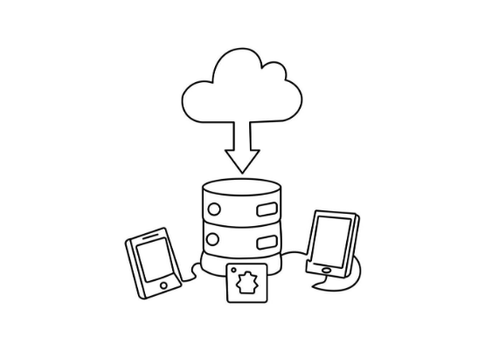
Architecture & Data Flow
The modern application runs on Azure (App Service, AKS, Container Apps) with an assigned System-assigned Managed Identity.
The application seamlessly authenticates with Azure Entra ID to request an access token, requiring zero hardcoded client secrets.
Entra ID validates the app's identity and issues a short-lived, secure access token.
The application presents this token to Azure Key Vault, which validates RBAC permissions.
Key Vault securely returns the connection string, enabling the app to connect to the backend Database or API.

Slide 8


Integration with ASP.NET Core
Required NuGet Packages
Configuration Setup
To integrate Key Vault seamlessly, two primary Microsoft packages are required to bridge authentication and configuration:
Integration is transparent. By chaining a single method in Program.cs, secrets are loaded into the standard configuration dictionary:
Azure.Identity: Provides robust token credential classes (like DefaultAzureCredential) for Azure SDK authentication workflows.
Use builder.Configuration.AddAzureKeyVault(...) during application startup.
Azure.Extensions.AspNetCore.Configuration.Secrets: Enables Azure Key Vault to act as a native configuration provider within the standard ASP.NET Core dependency injection container.
It merges vault secrets with local appsettings.json, allowing secure overrides.
Eliminates the need to alter existing code; accessing Configuration["DbPassword"] fetches the value directly from the vault in production.

Slide 9









Authentication Methods
Managed Identity
Service Principal
Local Development
The gold standard for Azure-hosted workloads. Eliminates credentials entirely. The Azure platform automatically manages the identity lifecycle, reducing operational overhead and attack vectors.
Ideal for CI/CD pipelines (GitHub Actions, Azure DevOps), automated scripts, or applications hosted outside of Azure (on-premises, AWS) that require programmatic access via Client ID and Secret.
DefaultAzureCredential seamlessly authenticates using your local developer context. It dynamically checks Azure CLI, Visual Studio, or Azure PowerShell for an active, authorized login.

Slide 10
Security Best Practices
Adopt the Principle of Least Privilege Grant applications only 'Get' and 'List' permissions via Azure Role-Based Access Control (RBAC). Never grant 'Set' or 'Delete' permissions to runtime application identities.
Implement Automated Rotation Configure Key Vault rotation policies to automatically generate new secrets or keys before they expire. This minimizes exposure windows and ensures continuous compliance.
Isolate Environments Create entirely separate Key Vault instances for Development, Staging, and Production environments. Never share a single vault across boundaries to prevent cross-contamination.
Enable Soft Delete & Purge Protection Safeguard against accidental or malicious deletion. Soft delete retains the vault data for a configured period (up to 90 days), allowing recovery without data loss.

Slide 11




Demo Execution Plan
2. Seed Configuration
4. Validate Access
Add a sample database connection string and a third-party API key as stored secrets.
Run the application locally and demonstrate successful retrieval of secrets via a secure endpoint.
1. Provision Vault
3. Implement Code
Create an Azure Key Vault resource via the Azure Portal and establish RBAC access policies.
Configure an ASP.NET Core Web API to load secrets dynamically using DefaultAzureCredential.

Slide 12

Questions?
Thank you for your time and engagement.

Slide 13


Image Sources
https://static.vecteezy.com/system/resources/thumbnails/076/516/322/large/hooded-hacker-working-laptop-abstract-data-code-background-red-blue-light-cyber-security-digital-crime-network-threat-data-breach-concept-anonymity-dark-web-internet-technology-video.jpg
Source: www.vecteezy.com
https://static.vecteezy.com/system/resources/previews/067/822/143/non_2x/cloud-storage-continuous-line-drawing-modern-minimalist-outline-illustration-artwork-vector.jpg
Source: www.vecteezy.com

